Slide 1
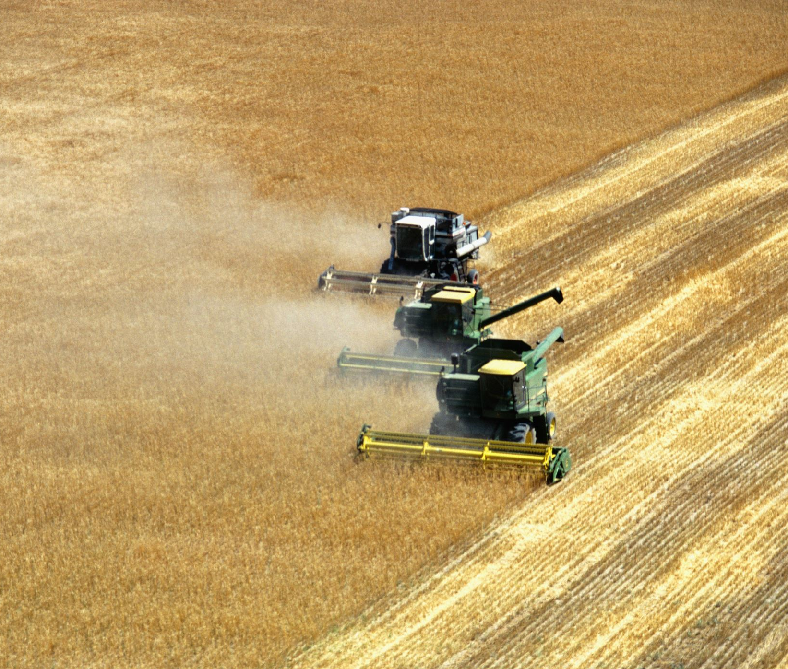
CROP RECOMMENDATION SYSTEM
Neha Nagesh Shetty
Rachana Anil
Savitha Munirajaiah

Slide 2
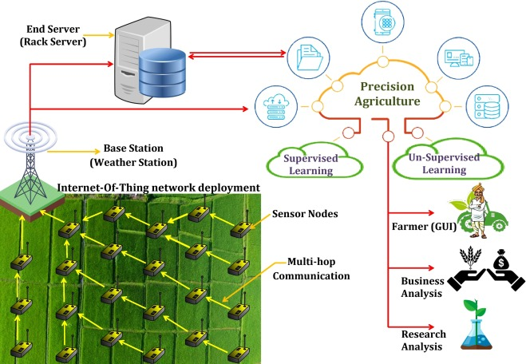
Precision Agriculture
Some data of soil parameters collected by Sensor Nodes are:
Soil Temperature
Humidity
Ph value
Nitrogen level
Phosphorous level

Slide 3
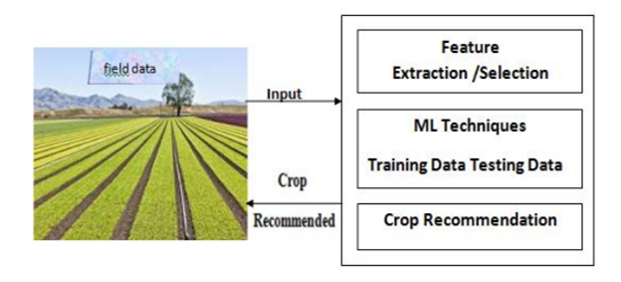
Crop Recommendation System
Basic Idea
Input: Weather condition parameters and Soil parameters
Output: A crop that is best suited to grow in the given conditions.

Slide 4
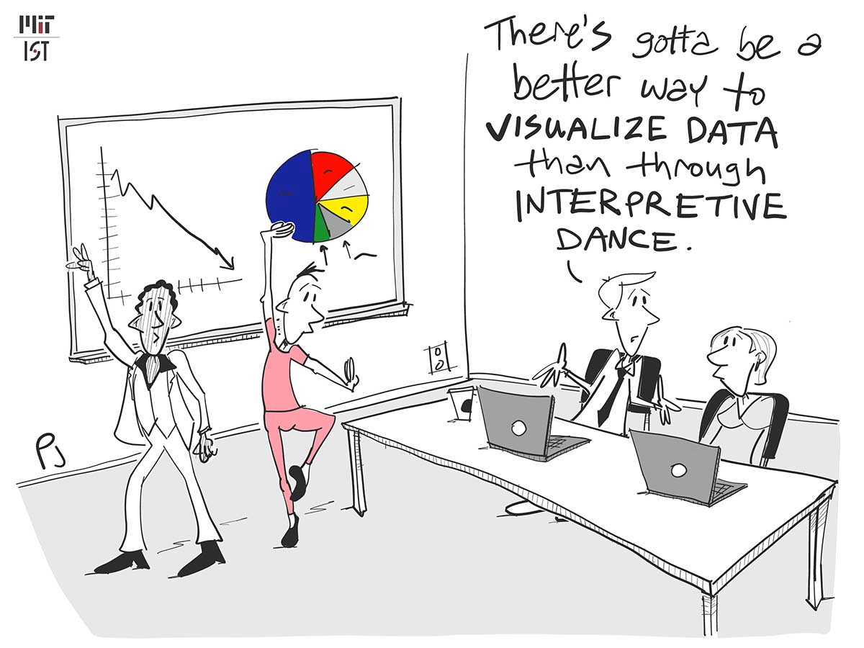

Slide 5
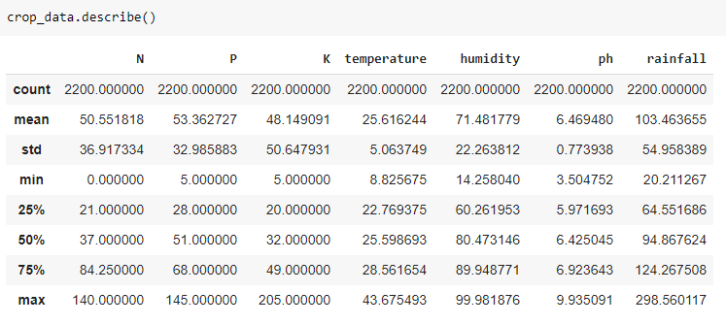
Data Visualization
Summary Statistics
- Large difference between overall spread of the features

Slide 6
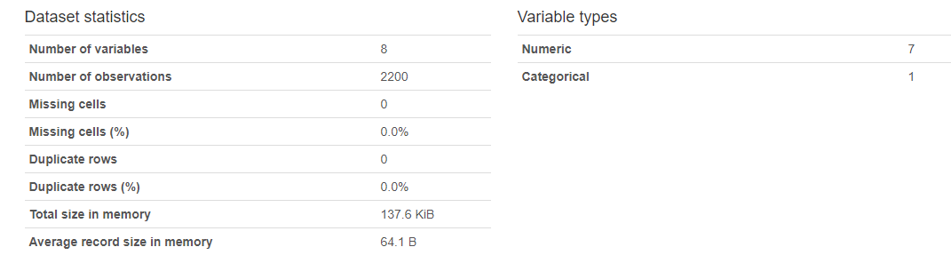
Profiling

Slide 7
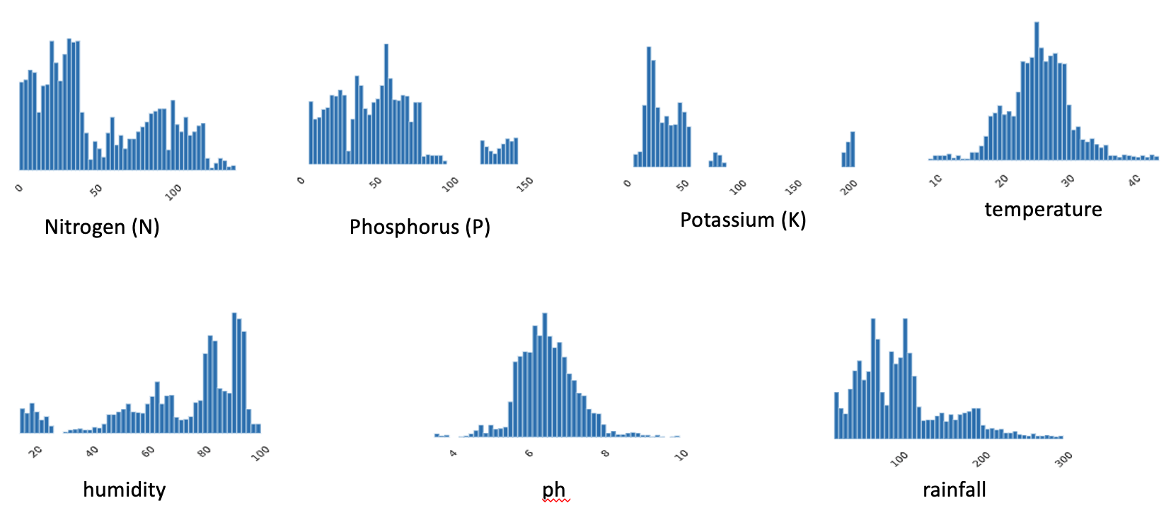
Univariate Analysis

Slide 8
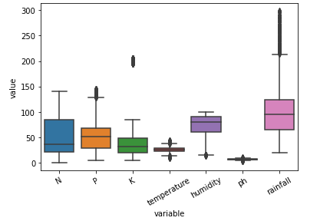
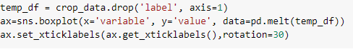
Box Plot
Data contains Outliers
Data points are NOT uniformly spread

Slide 9
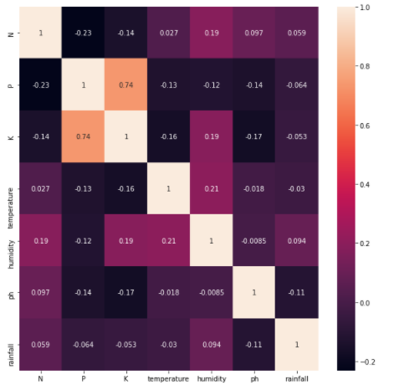
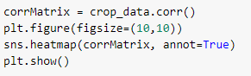
Bivariate
Analysis

Slide 10
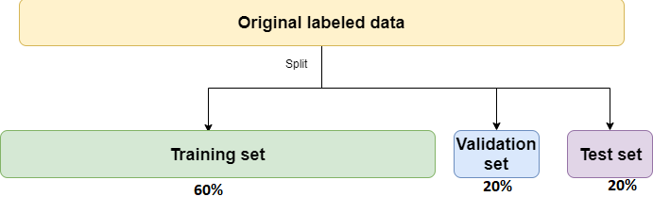
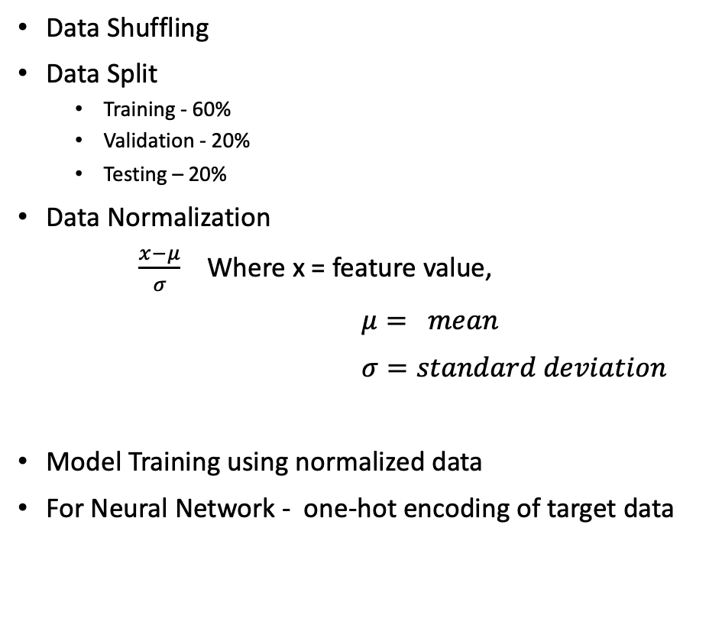
Inference
Data Shuffling
Data Split
Training - 60%
Validation - 20%
Testing – 20%
Data Normalization
$\frac{x−μ}{σ}$ Where x = feature value,
$μ= mean$
$σ=standard deviation$
Model Training using normalized data
For Neural Network - one-hot encoding of target data

Slide 11

ALGORITHMS
Multi-Level Perceptron
Gaussian Naive Bayes
K- Nearest Neighbor
Stochastic Gradient Descent Classifier
SVM
Decision Tree
Random Forest
Logistic Regression
Ridge and Lasso Regression
Gradient Boost
AdaBoost
XGBoost

Slide 12
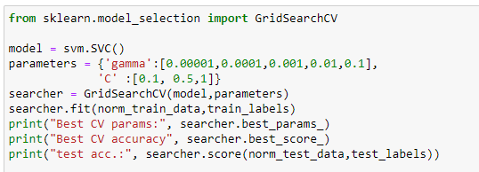
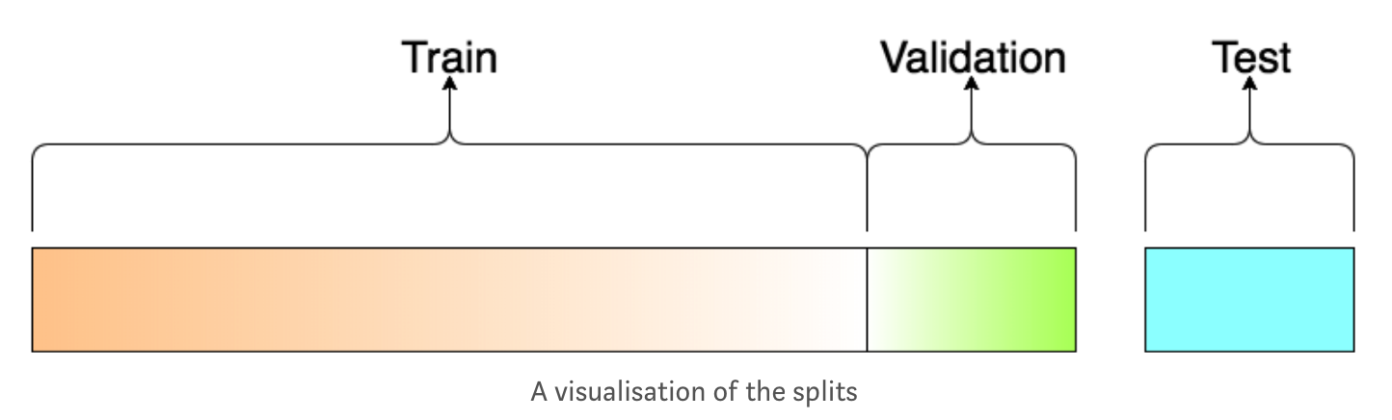
SUPORT VECTOR MACHINE
Hyperparameter tuning
Error Control Parameter(C) = 1
Gamma = 0.1

Slide 13
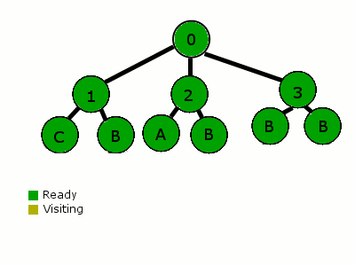
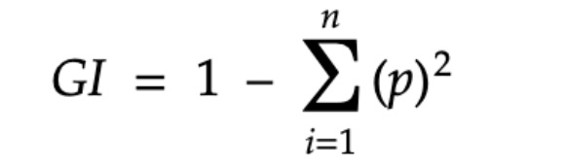
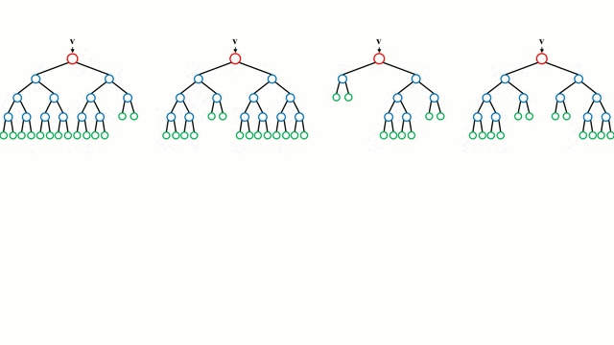
DECISION TREE
Gini criterion for splitting the nodes of a decision tree
RANDOM FOREST
Gini criterion for splitting the nodes of a decision tree in random forest
5 features are used to train the model

Slide 14
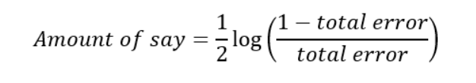

ADABOOST
Decision tree is used as a base estimator for ADABoosting
5 estimators are used to train the model
Learning rate chosen is 0.9
GRADIENT BOOST
Exponential loss function
Learning rate 0.1
Decision tree is used as base algorithm

Slide 15
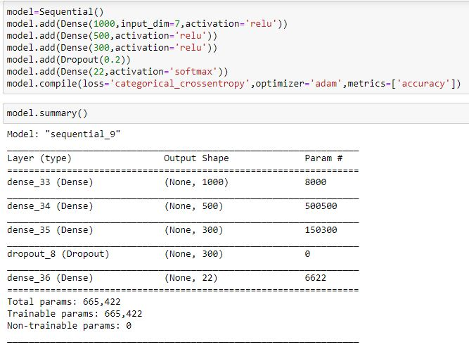
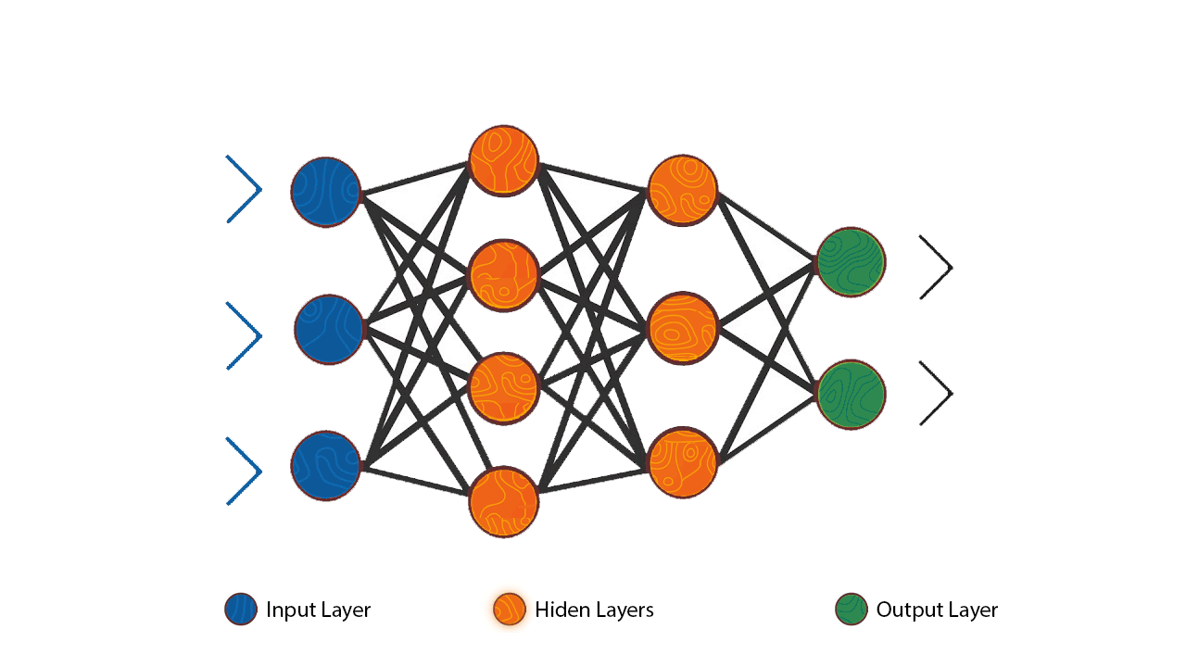
MULTILEVEL PERCEPTRON(NN)
NN model architecture
We are using a sequential model
7 inputs
We have used 2 hidden layers
Adam optimizer
Loss Function: Categorial cross entropy
22 outputs

Slide 16
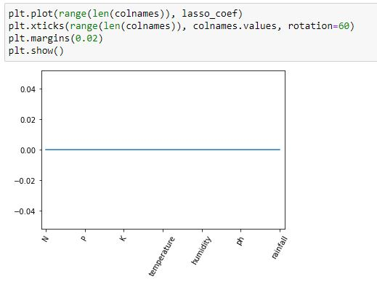
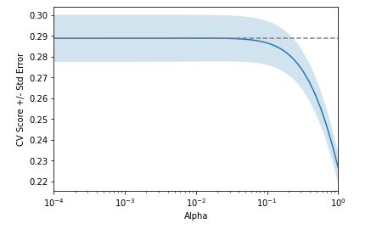
LASSO & RIDGE REGULARIZATION
Optimize the code with the help of regularization
L1 and L2 regression.

Slide 17
Performance Evaluation
Confusion Matrix
Classification Report
Accuracy

Slide 18
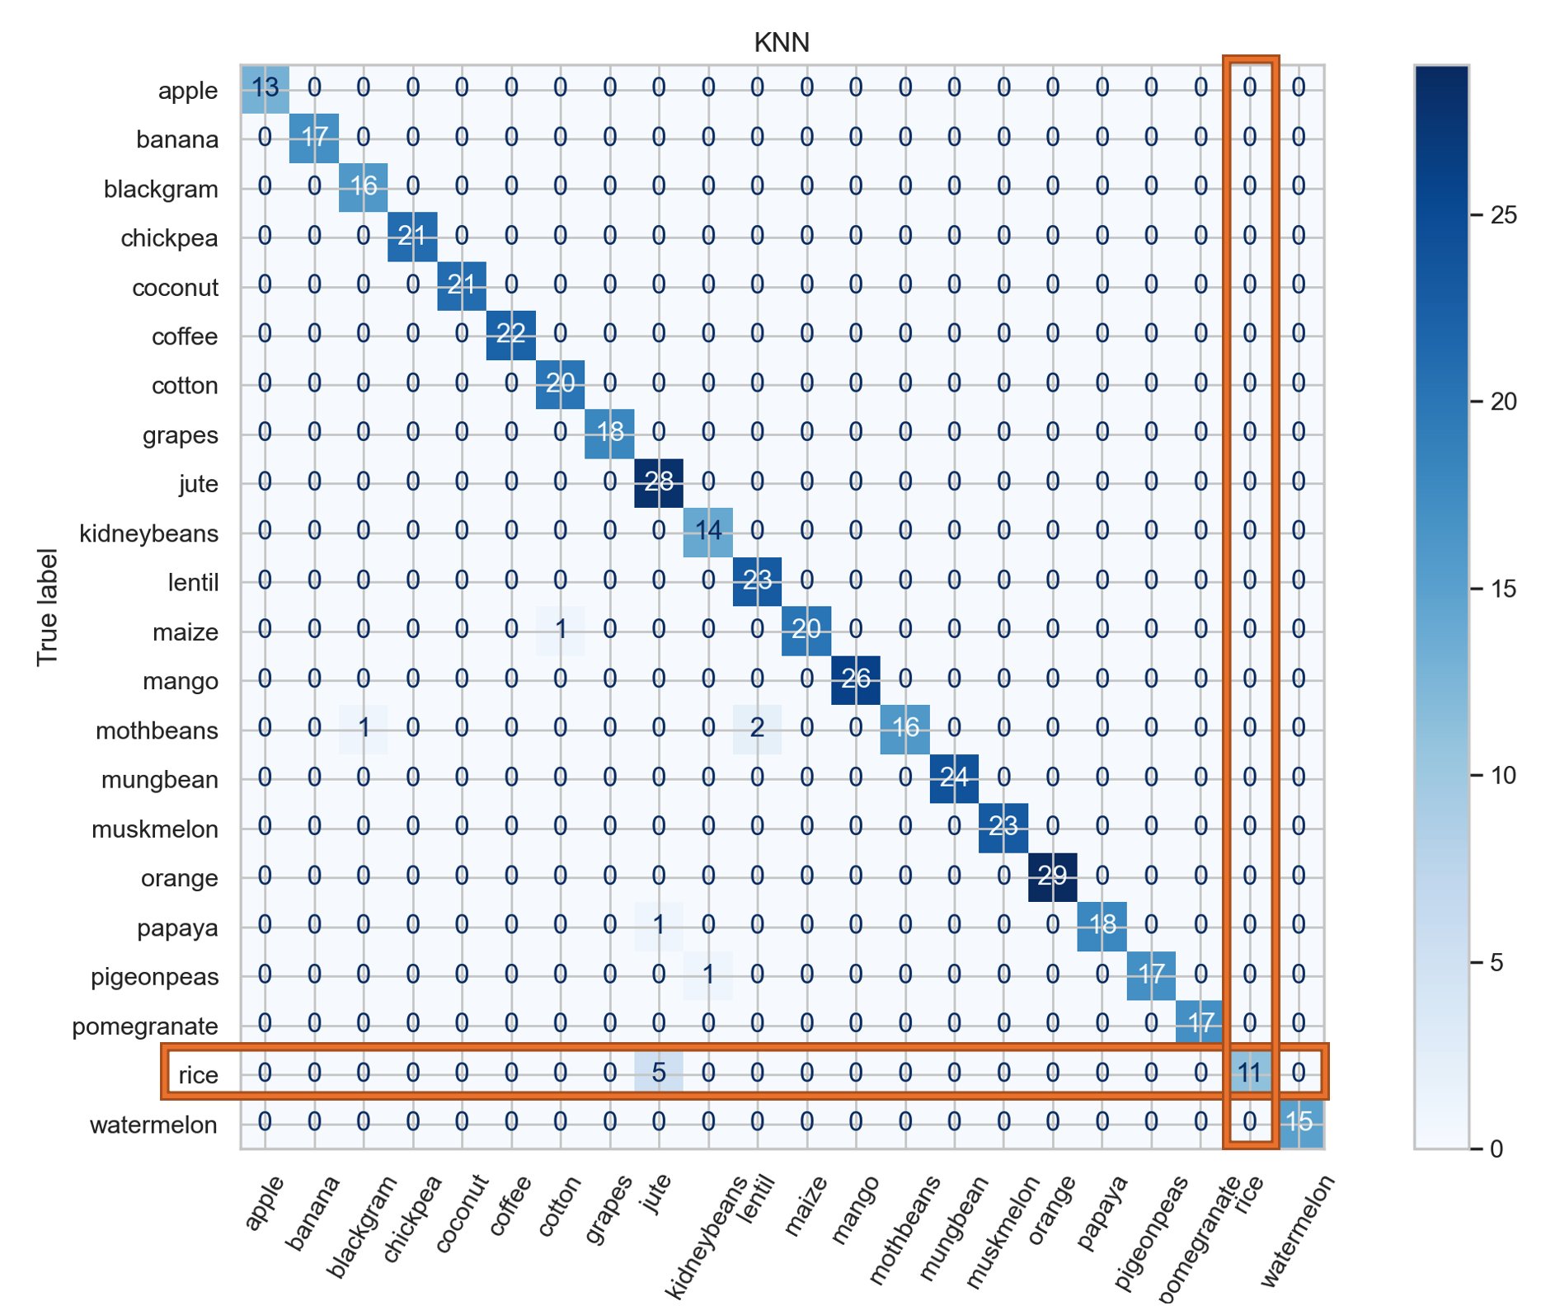

Confusion Matrix
K-Nearest Neighbor Model
Rice
TP = 11
FN = 5
FP = 0
TN = 440 – (11 + 5 + 0) = 424

Slide 19
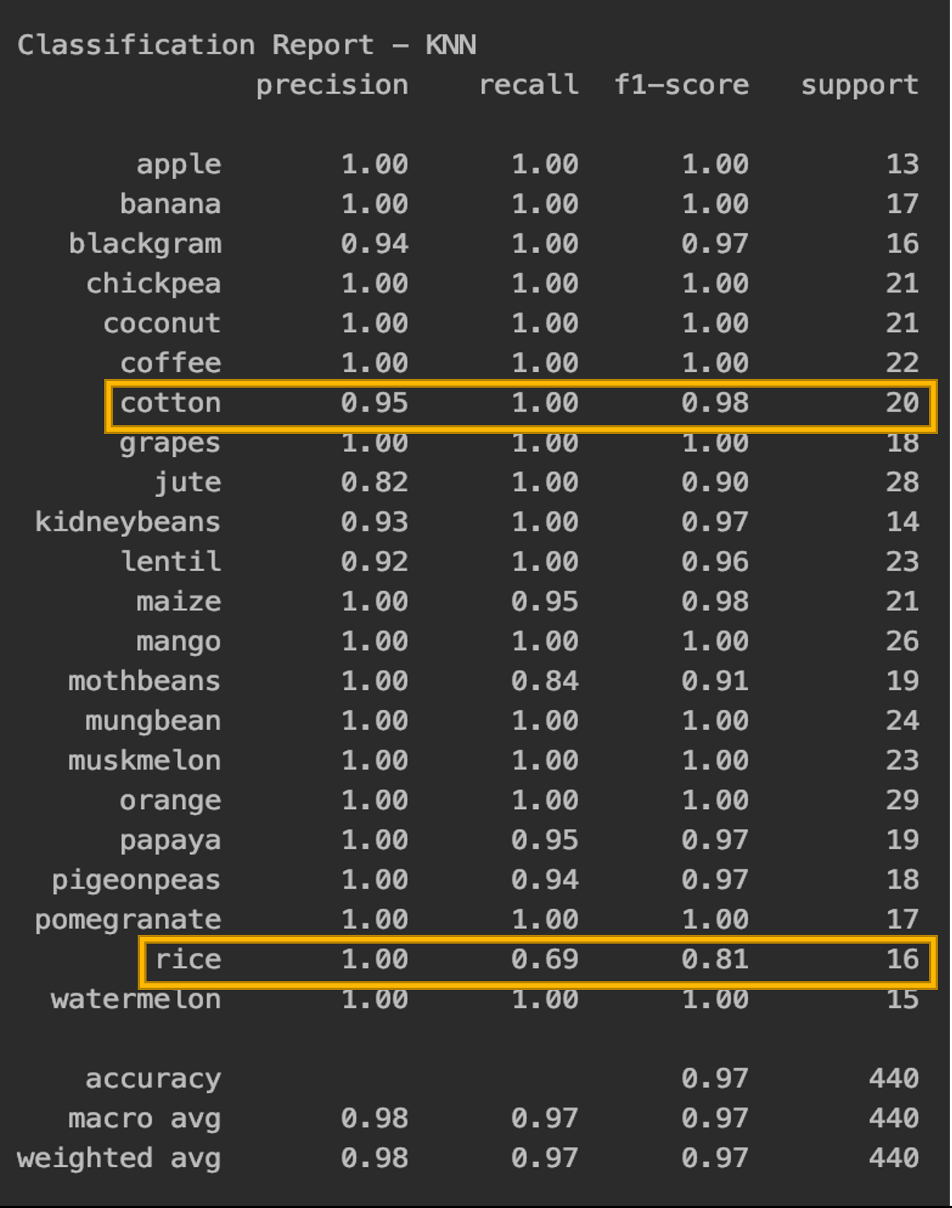
Classification Report
K-Nearest Neighbor Model
Precision — What percent of your predictions were correct?
Accuracy of positive predictions.
Precision = TP/(TP + FP)
= 98%
Recall — What percent of the positive cases did you catch?
Fraction of positives that were correctly identified.
Recall = TP/(TP+FN)
= 97%
F1 score — What percent of positive predictions were correct?
F1 Score = 2*(Recall * Precision) / (Recall + Precision)
= 97%

Slide 20
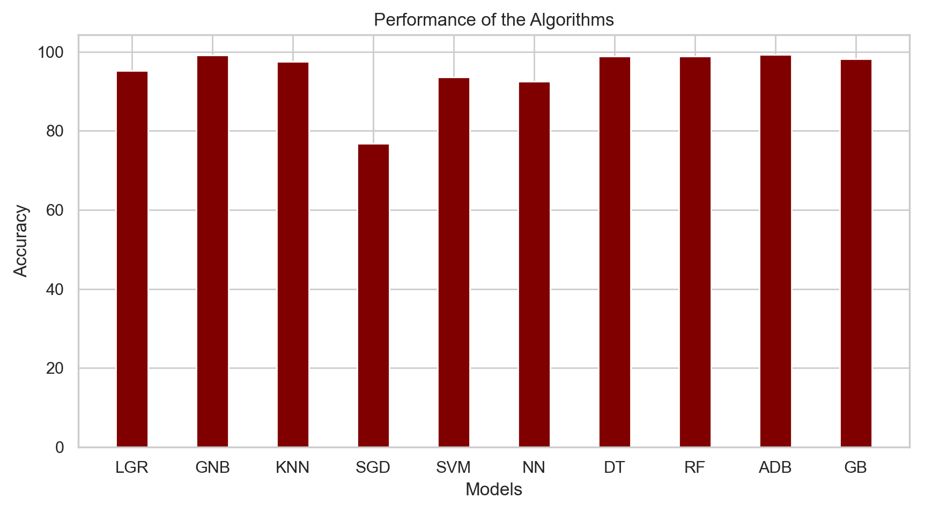
Accuracy
LGR = Logistic Regression KNN = K-nearest Neighbor SVM = Support Vector Machine DT = Decision Trees ADB = AdaBoost
GNB = Gaussian Naïve Bayes SGD = Stochastic Gradient Descent NN = Neural Nets RF = Random Forest GB = Gradient Boost

Slide 21
Next Phase
Optimize
Further optimize the top performing algorithms.
Generate
Generate new data randomly, supply it to the trained model, and evaluate its performance based on its recommendations
Implement
Implement XGBoost algorithm.

